Slide 1
Nuts & bolts of image recognition
Janu Verma
Hike, New Delhi
@januverma

Slide 2

About Me
Sr. Machine Learning Scientist at Hike, New Delhi — deep learning, recommendation
systems, NLP, network analysis.
Previously :
IBM Research, New York
Cornell University
Kansas State University
Cambridge University
Researcher in machine learning , data visualization, and mathematics.
Public Speaking, Teaching ML and data science.
Advise Startups on ML, data science, and hiring & team building.

Slide 3
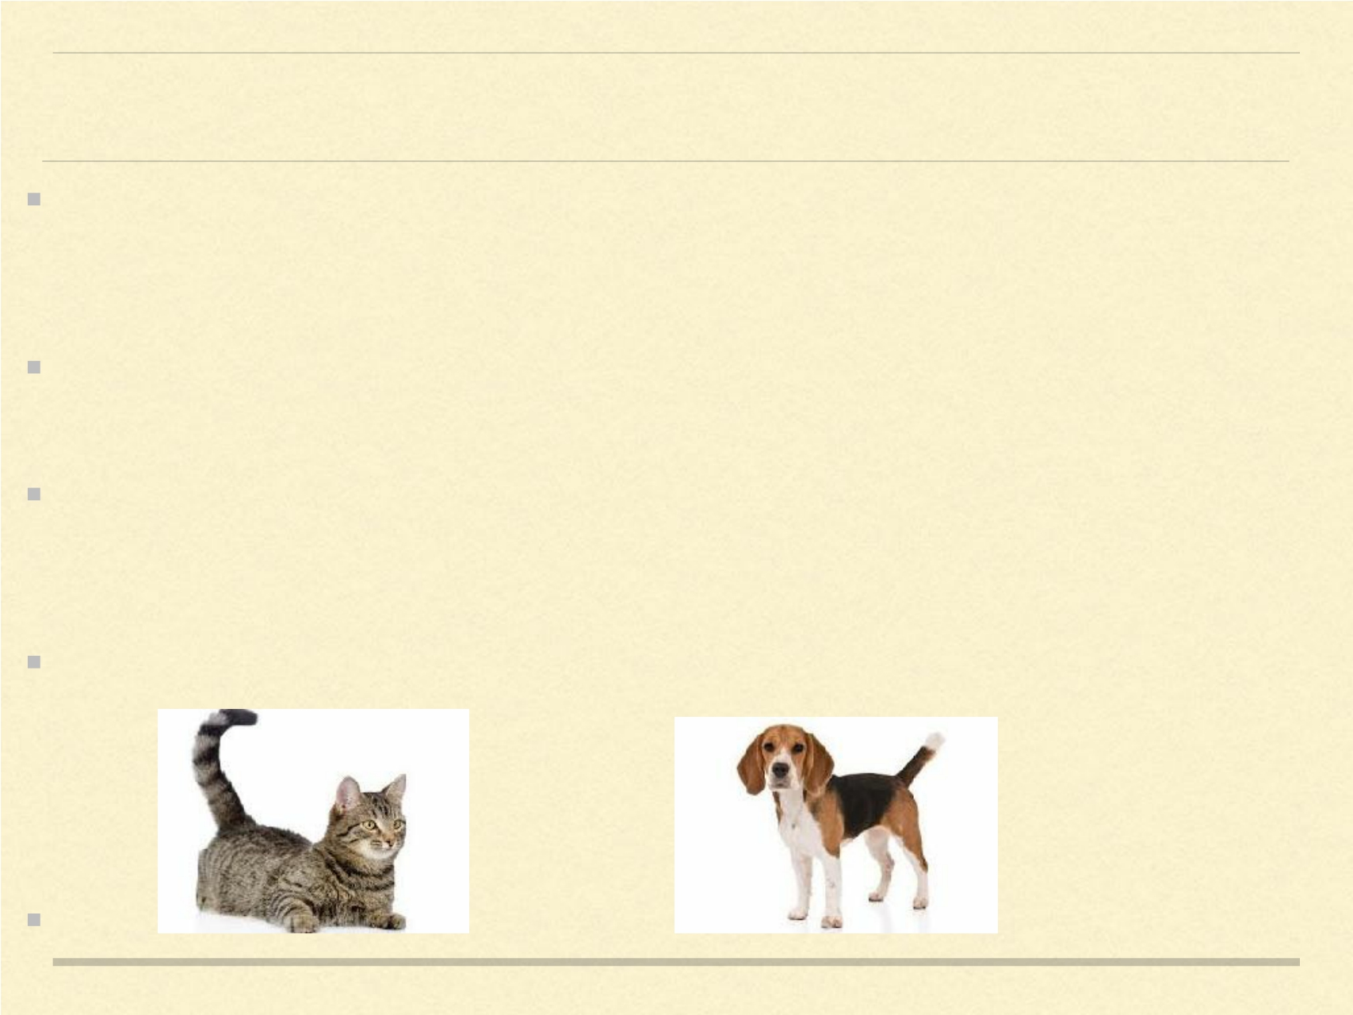
Machine Learning
Machine learning is a field of computer science that designs systems with the
ability to automatically learn and improve from experience without being explicitly
programmed.
Computer systems that access data and use statistical/mathematical techniques to
learn patterns and make inference based on probabilistic responses.
Supervised learning involves providing example inputs and respective outputs to the
the program, which ‘learns’ to make predictions on the outputs for new, unseen
inputs.
e.g. a classification system to categorize the images as cats or dogs.

Slide 4
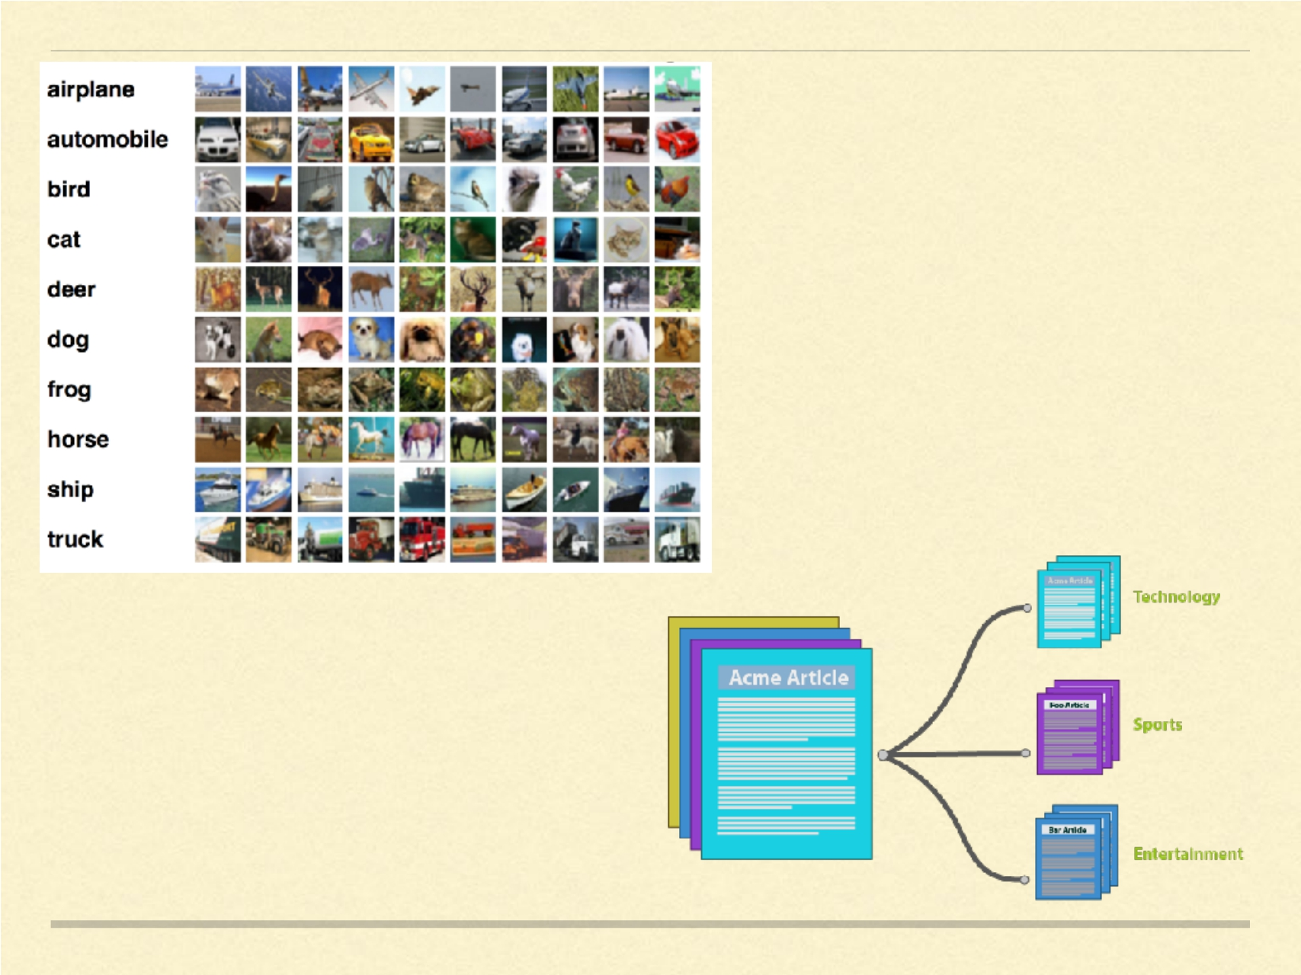

Slide 5
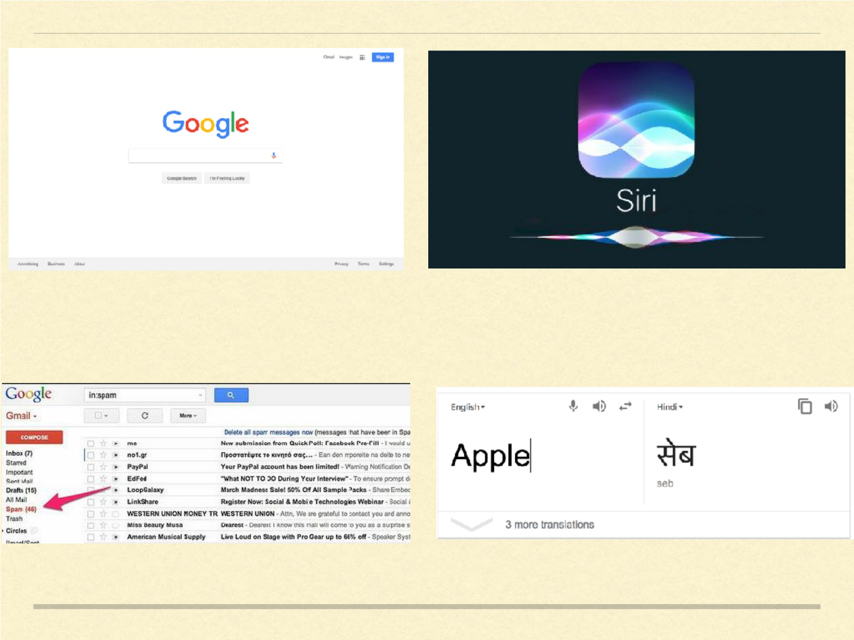

Slide 6
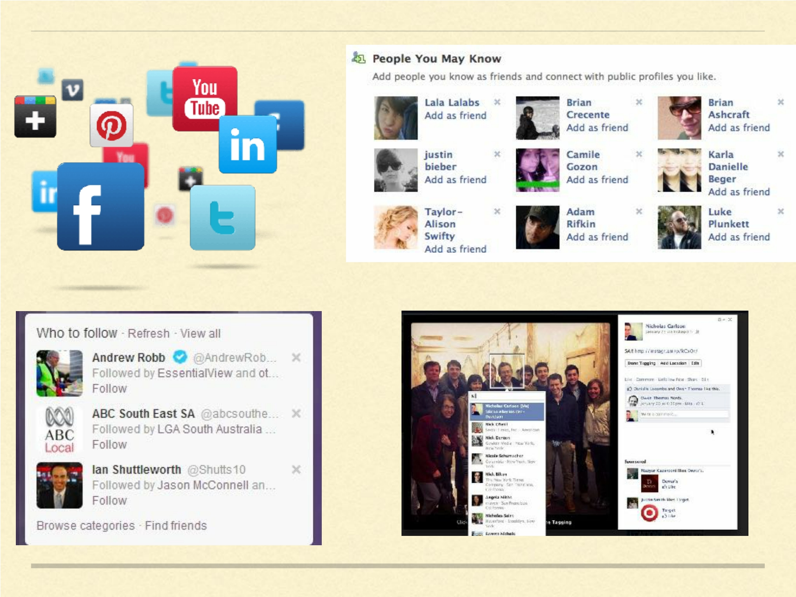

Slide 7


Slide 8
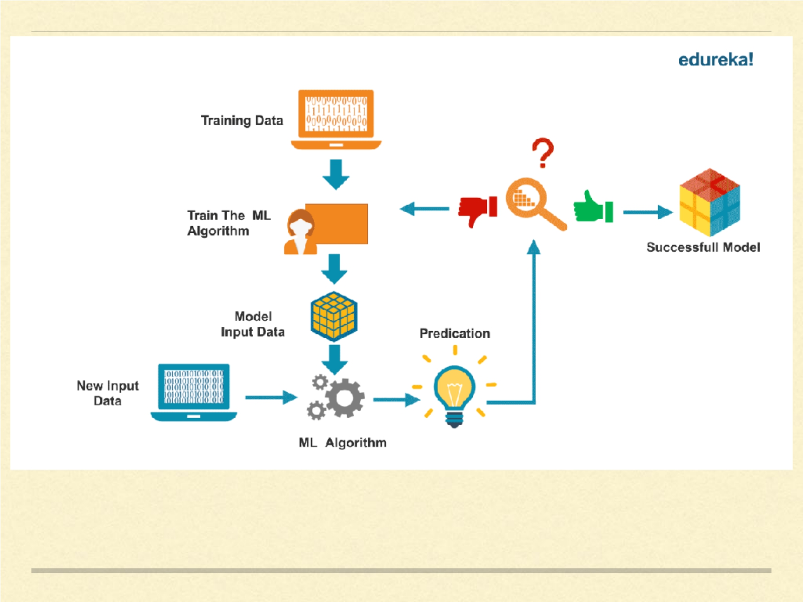
Machine Learning Pipeline

Slide 9
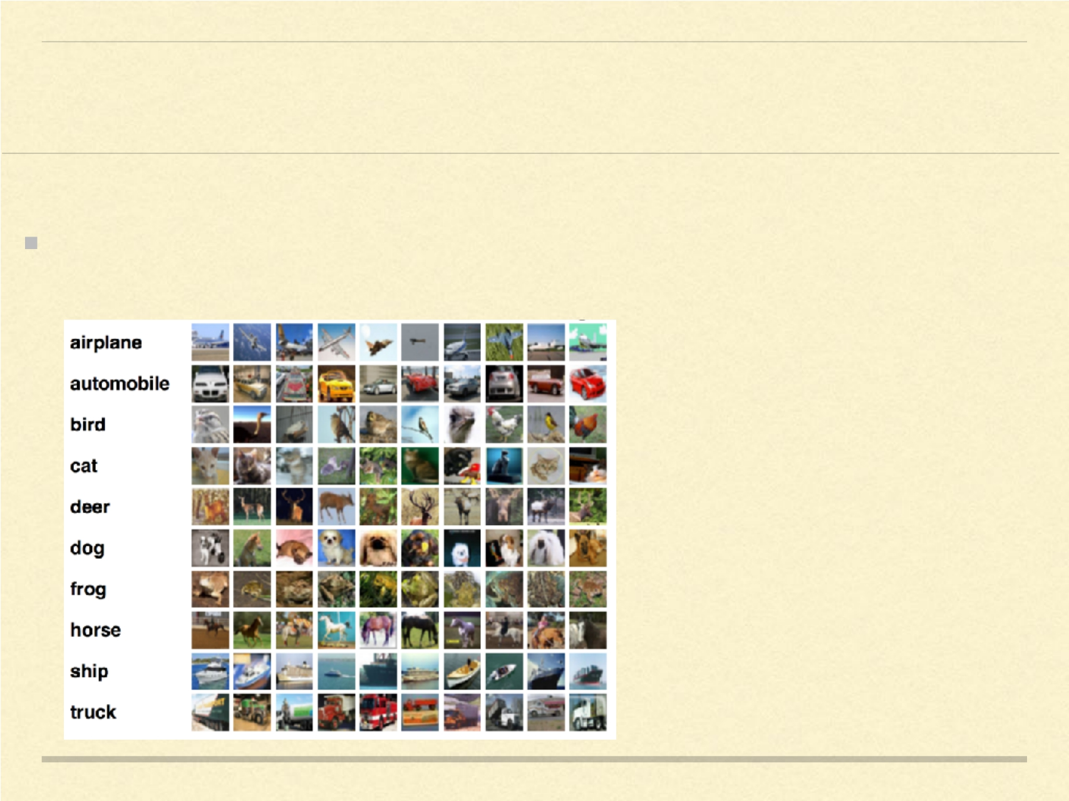
IMAGE RECOGNITION
Identify objects in the images.

Slide 10
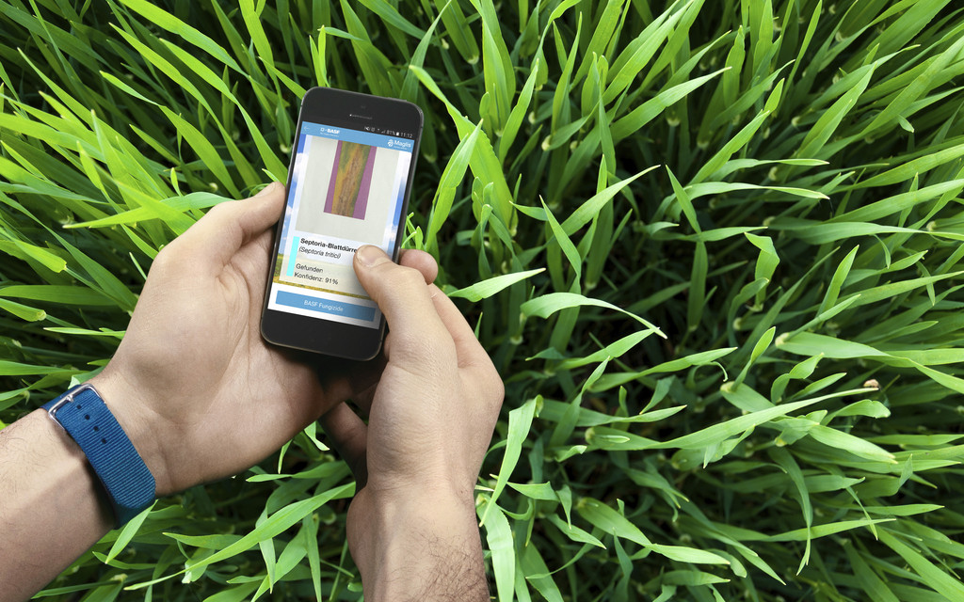
Analyze photographs of suspicious spots on crop leaves and deliver early warnings for diseases such as wheat leaf rust

Slide 11
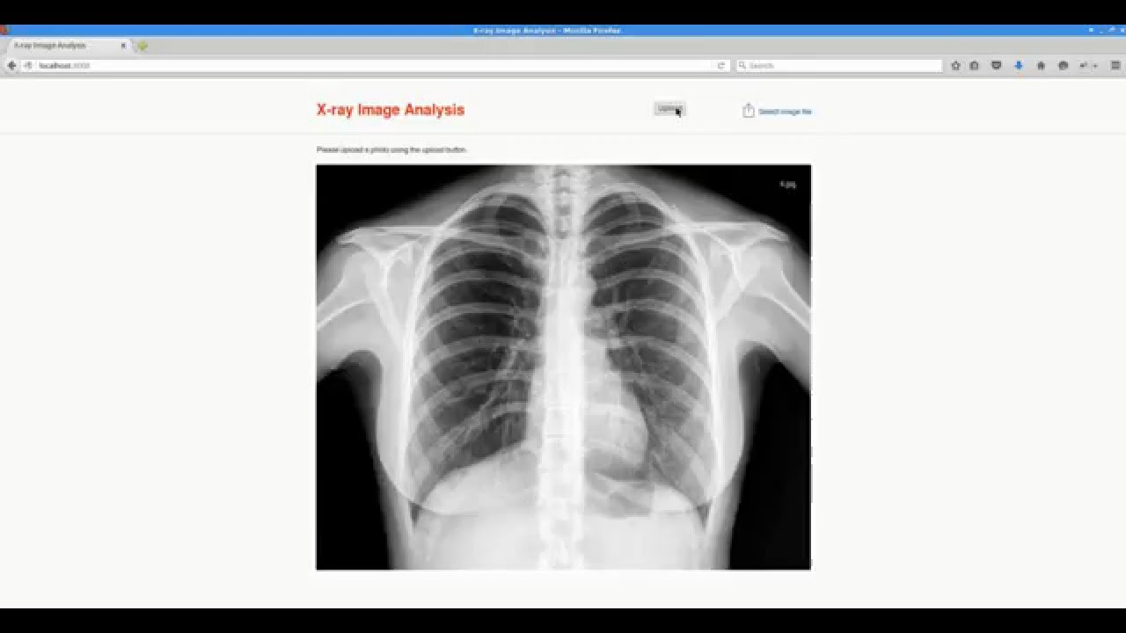
Image recognition for radiology

Slide 12

Deep Learning
Deep learning has seen tremendous success in past few years with State-of-The-Art
performance in many real-world applications.
All examples mentioned earlier are dominated by deep learning models.
But training a decent deep learning model requires large amount of data.
Success of deep learning can be attributed to development of great computation
resources (e.g. nvidia, distributed systems) and availability of huge amount of data
(Google).
Deep learning tools existed, but data was missing to actualise the full potential.
Only big companies have data large enough for deep learning.
Again: Algorithms open, data proprietary.

Slide 13
Neural Networks
Consists of layer of neurons (computational units).
Information flows from one layer to another.
Arranged as a network of layers and neurons.
Essentially each neuron takes some inputs and applied a non-linear function on the linear combination of the inputs.
If x1, x2, x3 are the inputs to the neuron, then the output of the neutron will be f(w1x1 + w2x2 + w3x3), where w’s are the weights that we want to learn. f is the non-linear activation function.

Slide 14
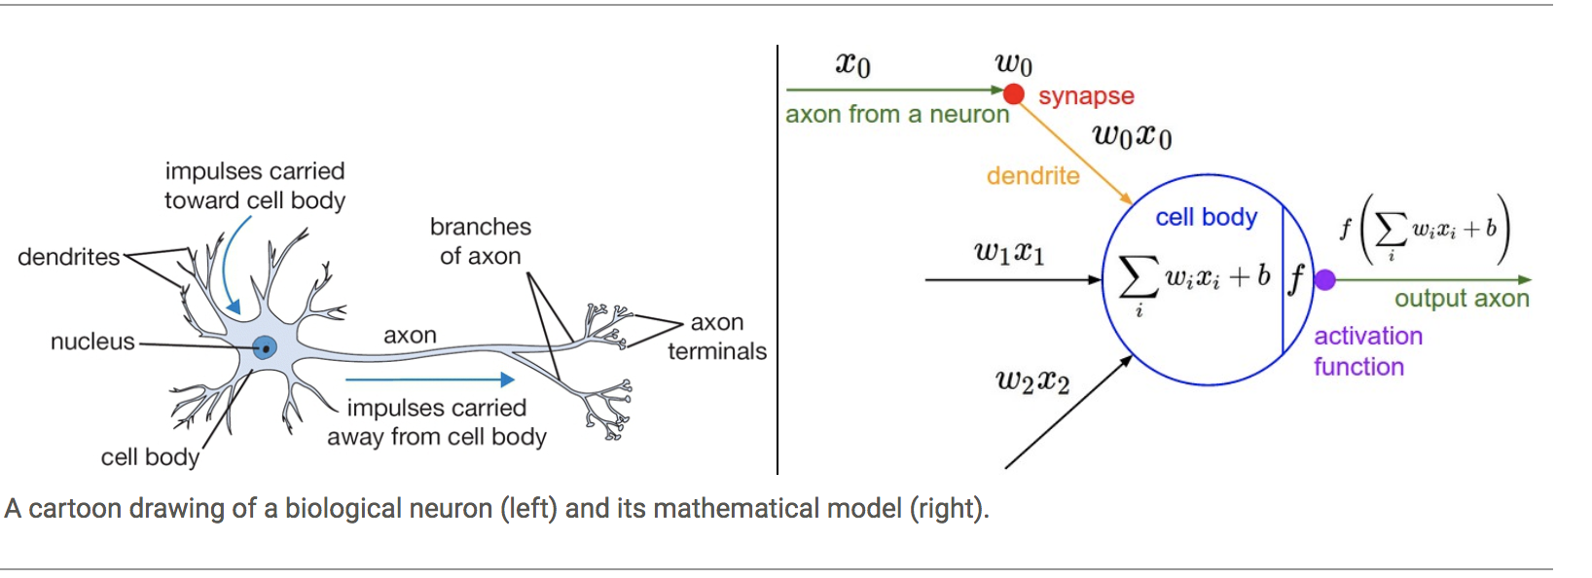

Slide 15
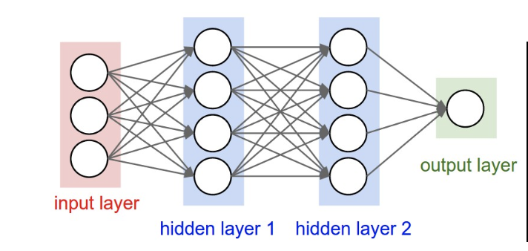

Slide 16
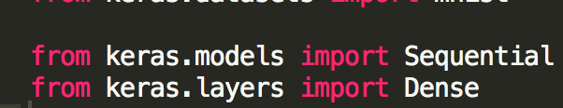
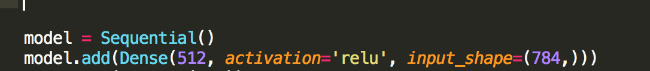

Slide 17
CONVOLUTIONAL NEURAL NETWORKS
CNNs were responsible for major breakthroughs in
Image Classification.
Core of most Computer Vision systems today, from Facebook’s
automated photo tagging to self-driving cars.
Also being applied to NLP problems like text classification.
A CNN comprises of many convolutional layers which perform a
‘ convolution ’ operation on the previous layer instead of a ‘feed-
forward ’

Slide 18
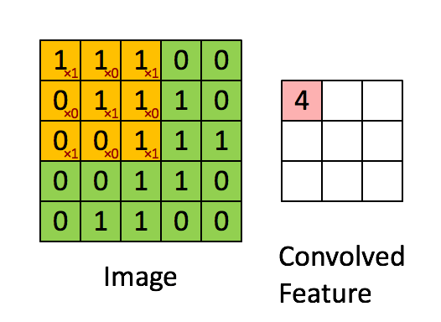
A convolution can be though of as a sliding window function applied
to a matrix

Slide 19
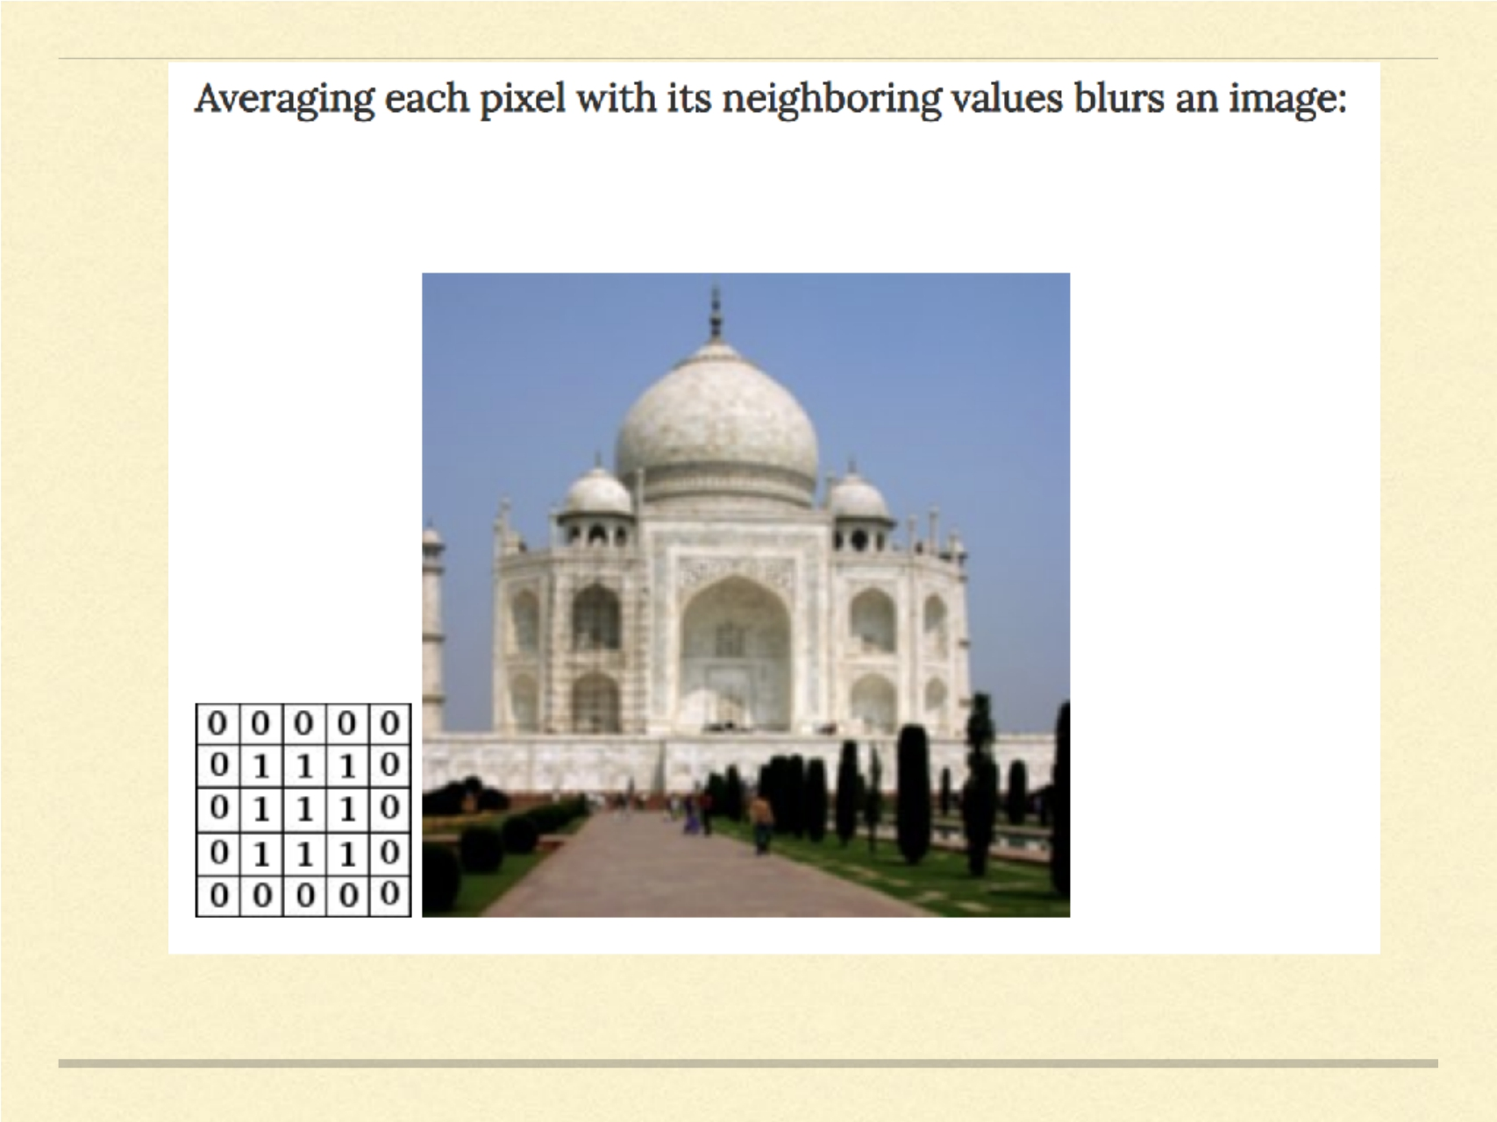
cf: Denny Britz, WildML

Slide 20
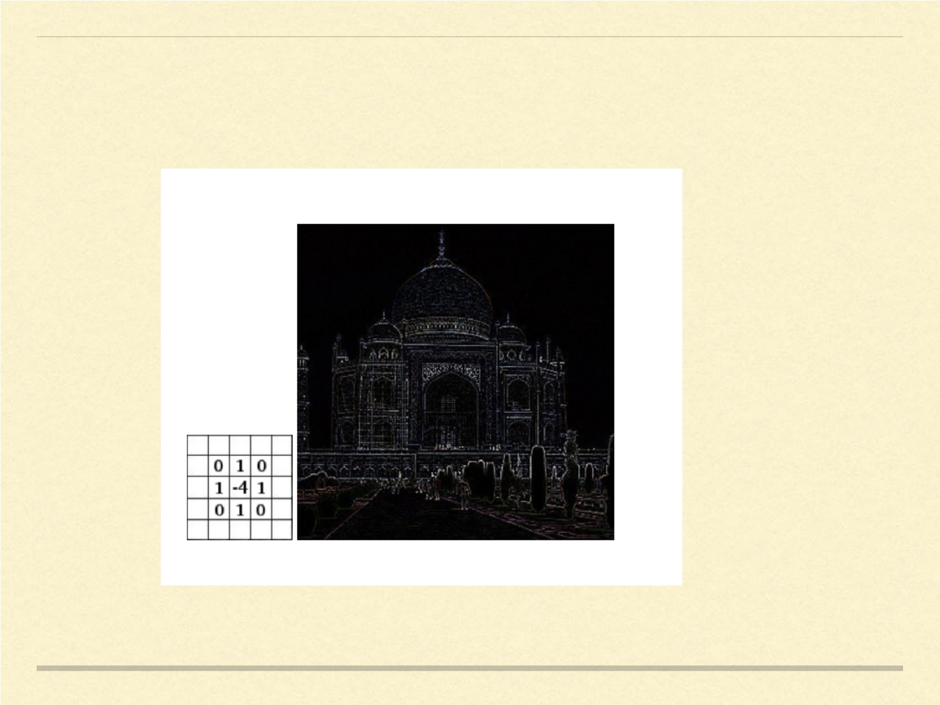
Edge detection by convolutions

Slide 21

CNN
CNNs are basically just several layers of convolutions with nonlinear activation
functions like ReLU or tanh applied to the results .
Traditional feed-forward networks - each input neuron to each output neuron in
the next layer.
CNNs - Convolutions over the input layer to compute the output .
Local connections - each region of the input is connected to a neuron in the
output.
Each layer applies different filters, typically hundreds or thousands like the ones
showed above, and combines their results.
Also pooling layers.

Slide 22

Let’s say you want to classify whether or not there’s an elephant in
an image. Because you are sliding your filters over the whole image
you don’t really care where the elephant occurs. In practice,
pooling also gives you invariance to translation, rotation and scaling,
but more on that later. The second key aspect is (local)
compositionality . Each filter composes a local patch of lower-level
features into higher-level representation. That’s why CNNs are so
powerful in Computer Vision. It makes intuitive sense that you
build edges from pixels, shapes from edges, and more complex
objects from shapes.

Slide 23
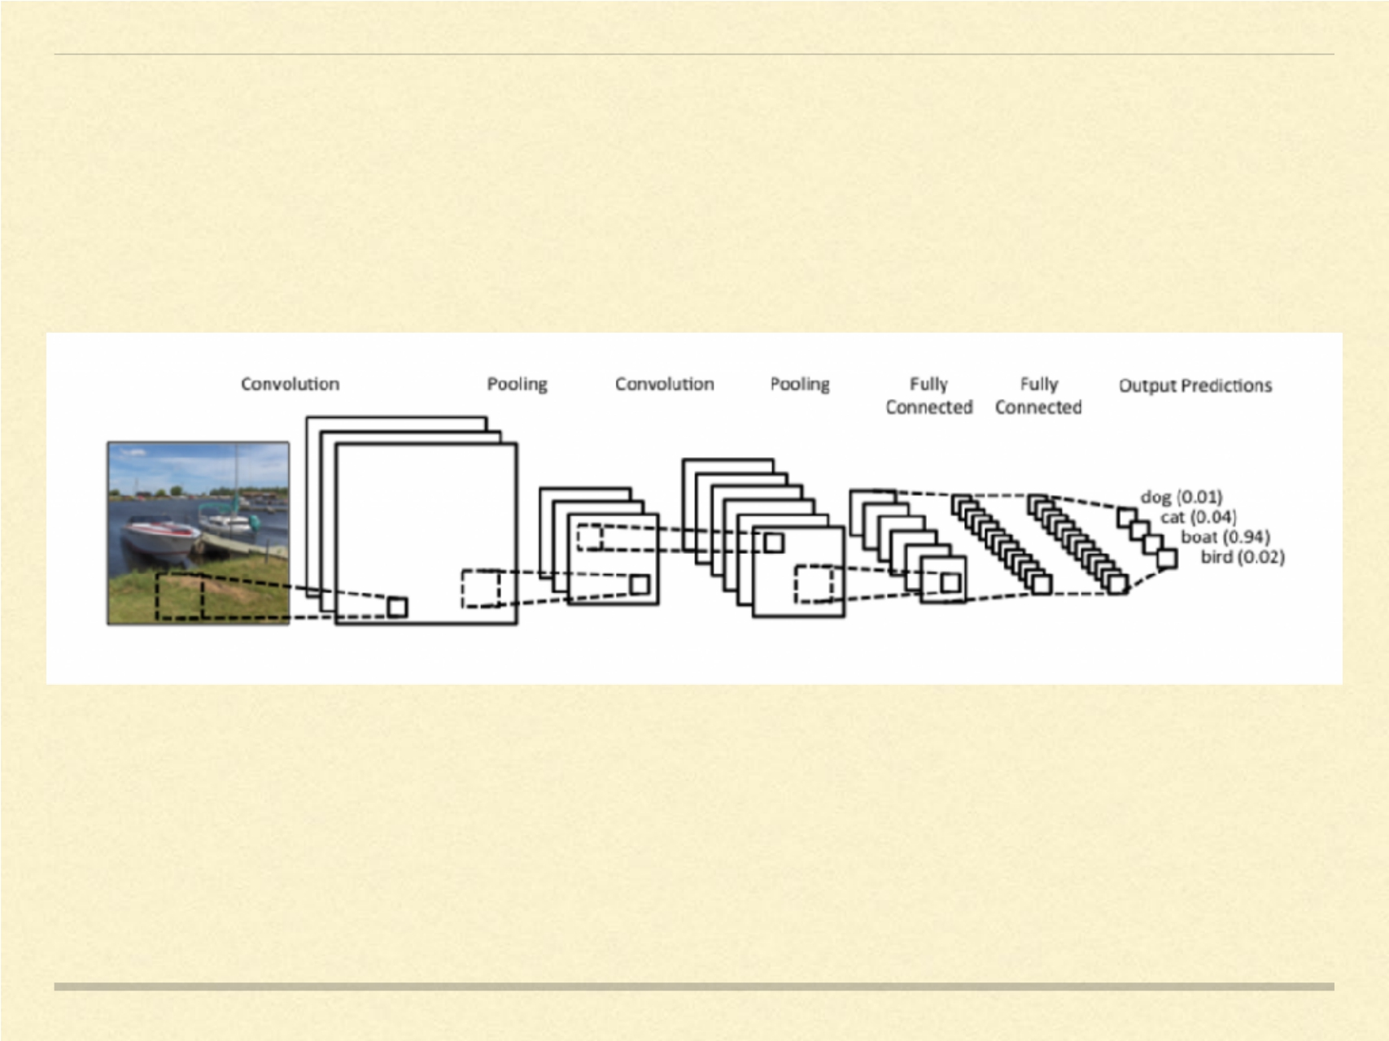
A typical convolutional neural network

Slide 24
Feed-forward nets for images
Regular feed-forward neural nets don’t scale well to the images.
If image has a size of 32*32*3 i.e. 32 height, 32 width, and 3 cooler channels (RGB).
Single neuron in the first hidden layer is connected to each of the inputs, and thus has 32*32*3 = 3072 weights.
Usually images are of 200*200*3 size, then the number of weights become 120,000.
If the input layer has 1000 units, this becomes 1.2M. With several layers this adds up quickly.

Slide 25
CNN for images
CNNs take advantage of the image structure of the input.
A CONV layer has filters which are the learnable parameters.
A filter of size 5*5 will operate on image of size 32*32*3 by sliding the 5*5 window over 32*32 area of each channel and computing the dot product.
We can have multiple filters each of which operates on the image to produce a new output matrix. The outputs can be stacked together to get a higher-dimensional result.
On a 32*32*3 image, using 10 5*5 conv filters, yields an output of 28*28*10.

Slide 26
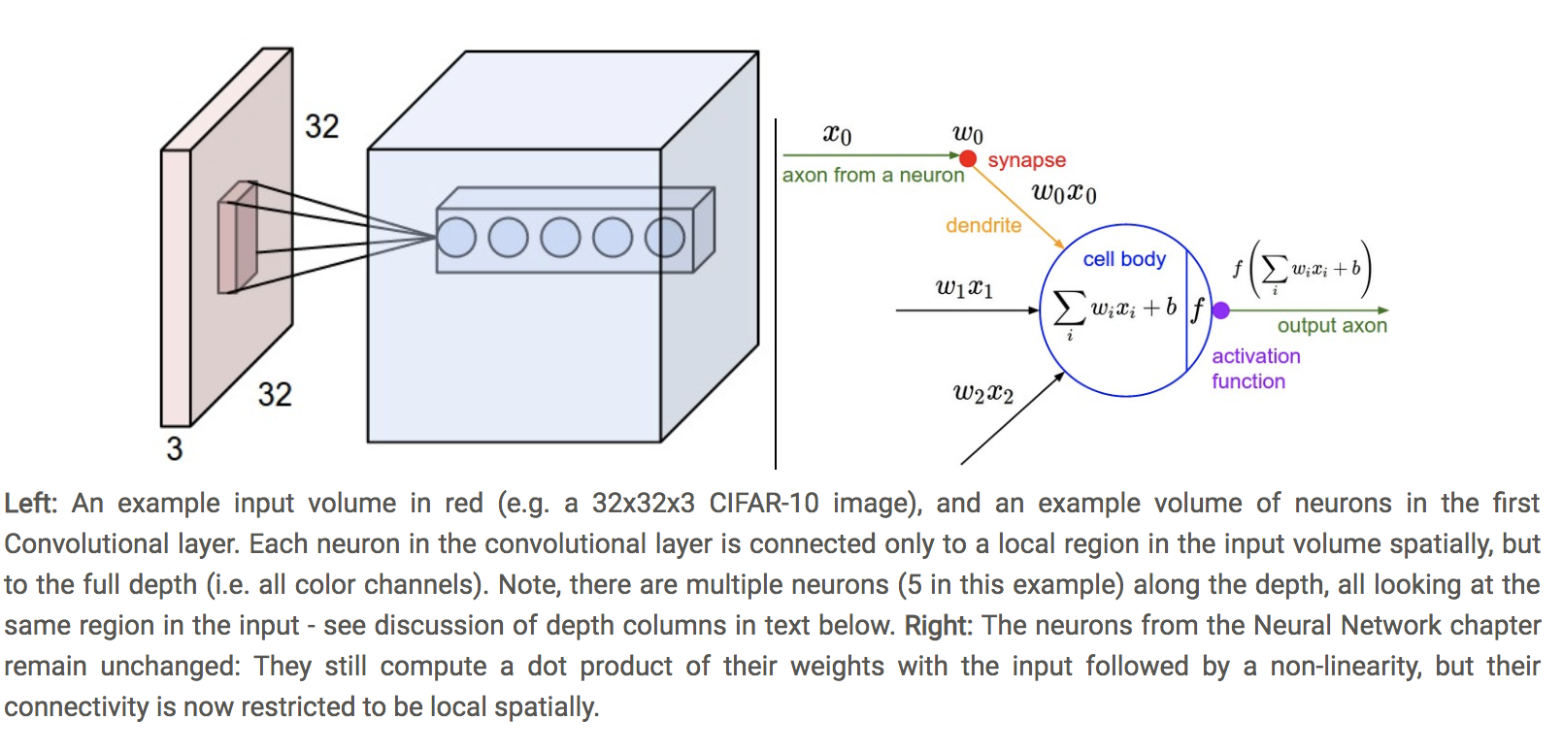

Slide 27
Parameter sharing
Control the number of parameters.
Assumption: If one features to useful to compute at some spatial position (x1 , y1), then it should also be useful at a different position (x2, y2).
The parameters of the Conv filters are shared across the input.
Thus the parameters of a conv filter do no depend on the size of the image, since same set of weights will be used for every pixel.
Parameters of a conv filter only depend on the filter size and number of filters. I
[5*5*3] * 10 parameters.

Slide 28
Pooling layers
Pooling: Add pooling layers in-between convolutional layers in a typical CNN.
Doesn’t matter where the feature is, all we need to know if there is a feature.
MaxPooling: take the maximum of the values in the output of a conv filter.
Progressively reduce the spatial size of the representation to reduce the amount of parameters and computation in the network, and hence to also control overfitting.

Slide 29
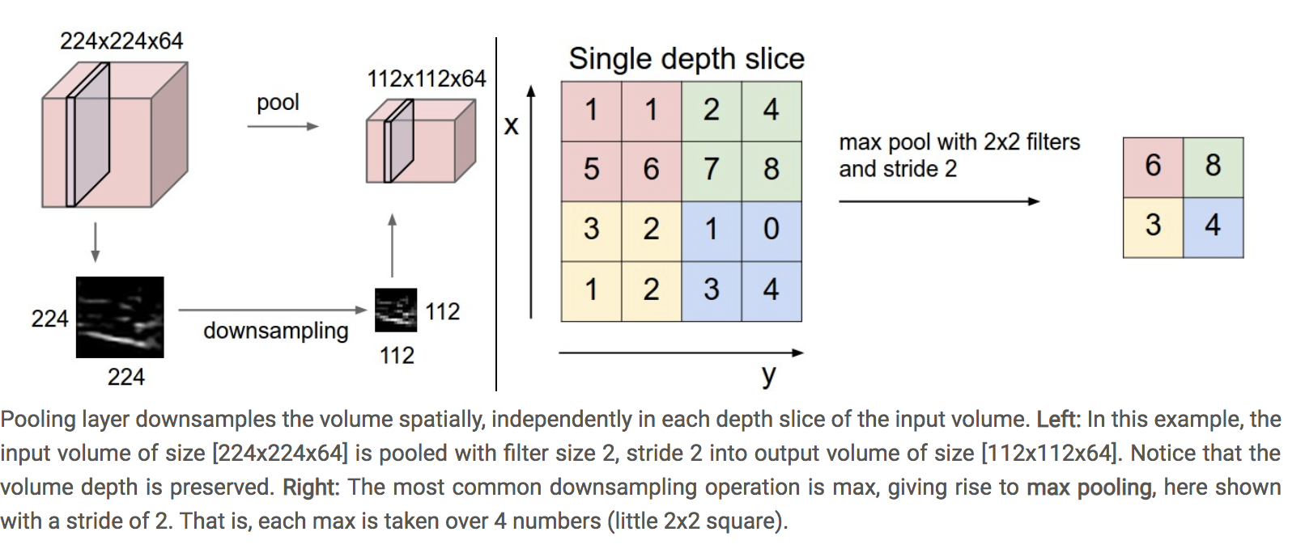

Slide 30
Hyperparameters
Number of filters: Each filter tries to learn a different feature by looking for some characteristic of the image. e.g. presence of oriented edges, or blobs of colour.
Stride: Amount with which we slide the filter. With stride one, move the filter one pixel at a time, with stride 2 move filter 2 pixels. Higher stride produces smaller output.
Padding: Not all pixels get seen by same number of filters. Pixels at the center get more focus than at the periphery. So padding (adding extra layers of 0) can be very useful. Also used to control the spatial size of the output.

Slide 31
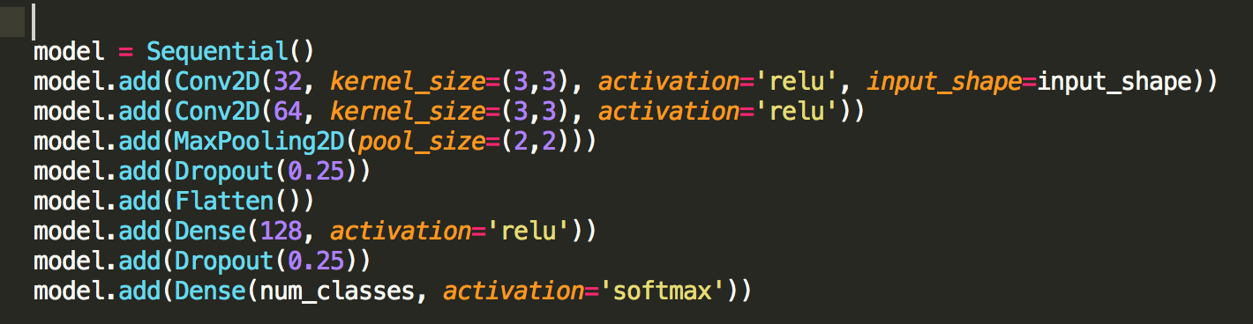

Slide 32
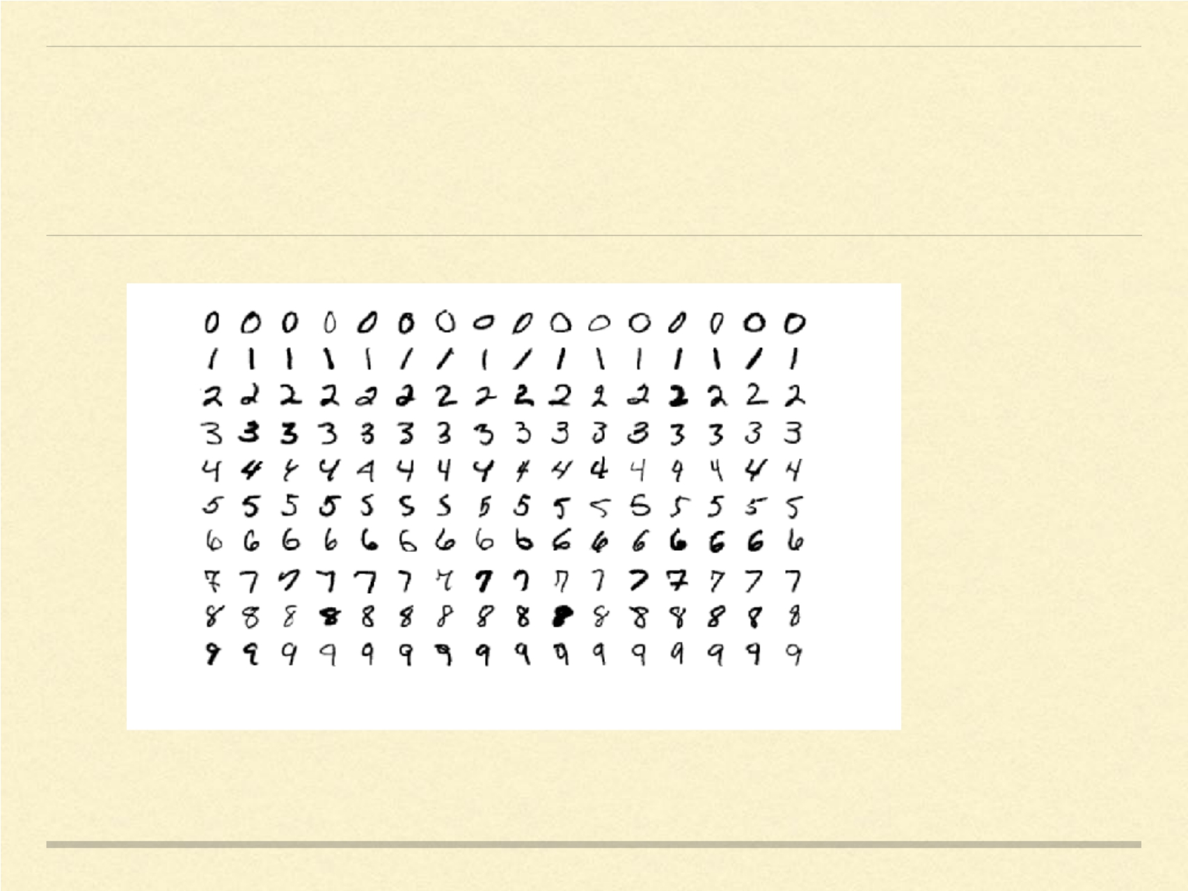
MNIST

Slide 33

MNIST
One of the most popular dataset for image analysis. Contains hand-written digits for
recognition.
60k training examples and 10k in test set.
Early success of neural networks.
Established efficacy of Convolution neural networks (ConvNets) in image recognition.
LeNet-5 : Deep ConvNet by Yan LeCun in 1998. Used by several banks to recongnize
hand-written numbers of checks.
Many new deep ConvNet architectures have been proposed to improve performance
on this dataset.
SOTA : Dynamic Routing Between Capsules (Sabour, Frost, Hinton) Nov 2017

Slide 34
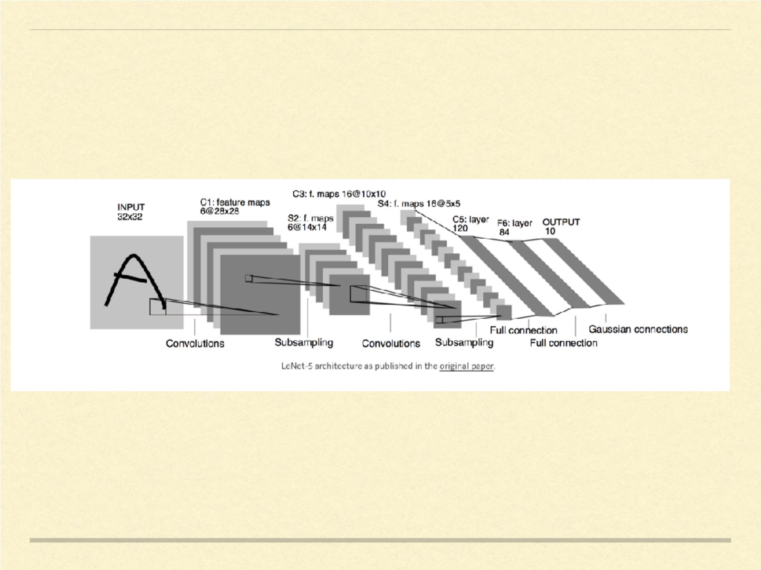

Slide 35

LENET - 5
First major application of Convolutional Neural Networks for image recoginition.
Provided foundation to all modern state-of-the-art computer vision models.
tanh activations used.
Average pooling scheme.
Not all convolutional filters were used by the whole image. For saving compute
time.
Achieves error rate of < 1%.

Slide 36
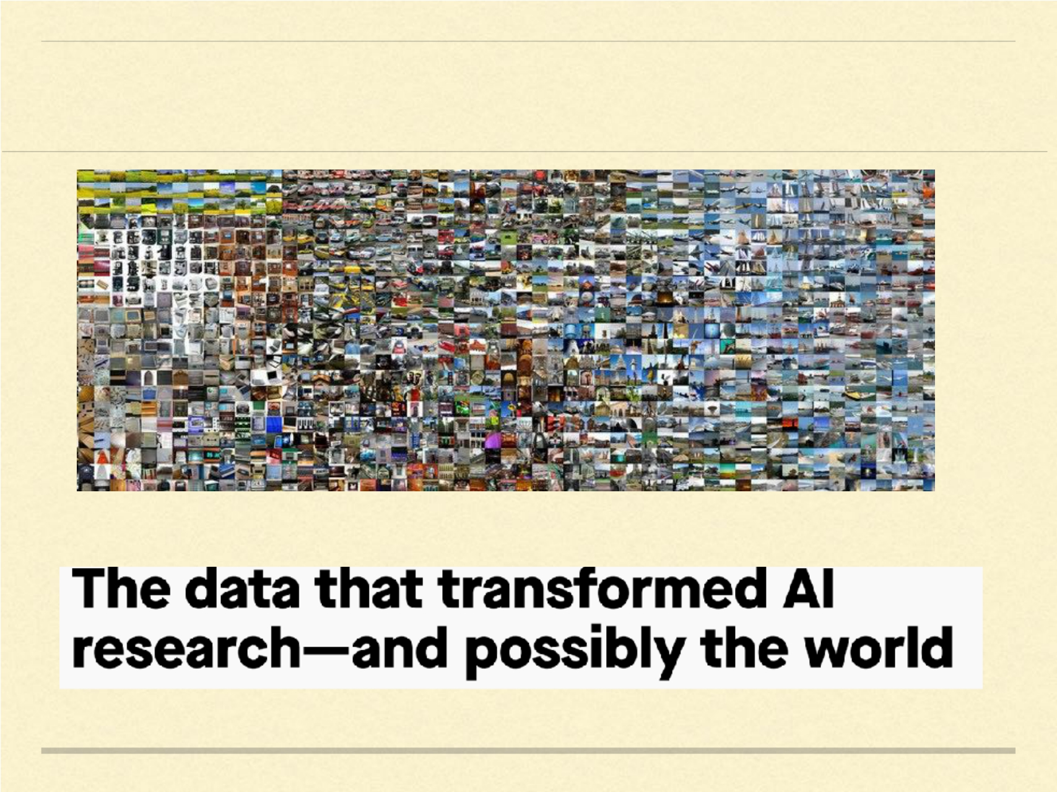
IMAGENET

Slide 37

IMAGENET
Data that changed everything. Big time!!
Fei Fei Li and team in 2009.
Previous datasets didn’t capture the variability of the real world.
Even identifying pictures of cats was infinitely complex.
WordNet: a hierarchal structure for the English language. Like a
dictionary, but words would be shown in relation to other words
rather than alphabetical order.
Idea: WordNet could have an image associated with each of the
words, more as a reference rather than a computer vision dataset.

Slide 38
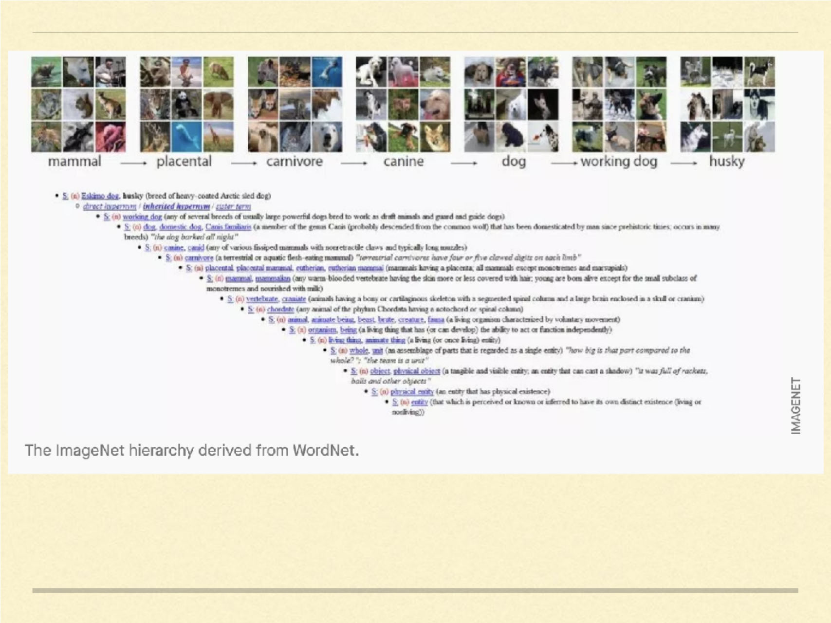
cf: http://www.image-net.org/papers/imagenet_cvpr09.pdf

Slide 39

IMAGENET
WordNet contains approximately 100,000 phrases and ImageNet has
provided around 1000 images on average to illustrate each phrase.
It consisted of 3.2 million labelled images, separated into 5,247
categories, sorted into 12 subtrees like “mammal,” “vehicle,” and
“furniture.”
Originally published as a poster in CVPR, without attracting much
fanfare.
“There were comments like ‘If you can’t even do one object well,
why would you do thousands, or tens of thousands of objects?” - Jia
Deng, co-creator of Imagenet.

Slide 40
If data is the new oil, it was still dinosaur bones in 2009.

Slide 41
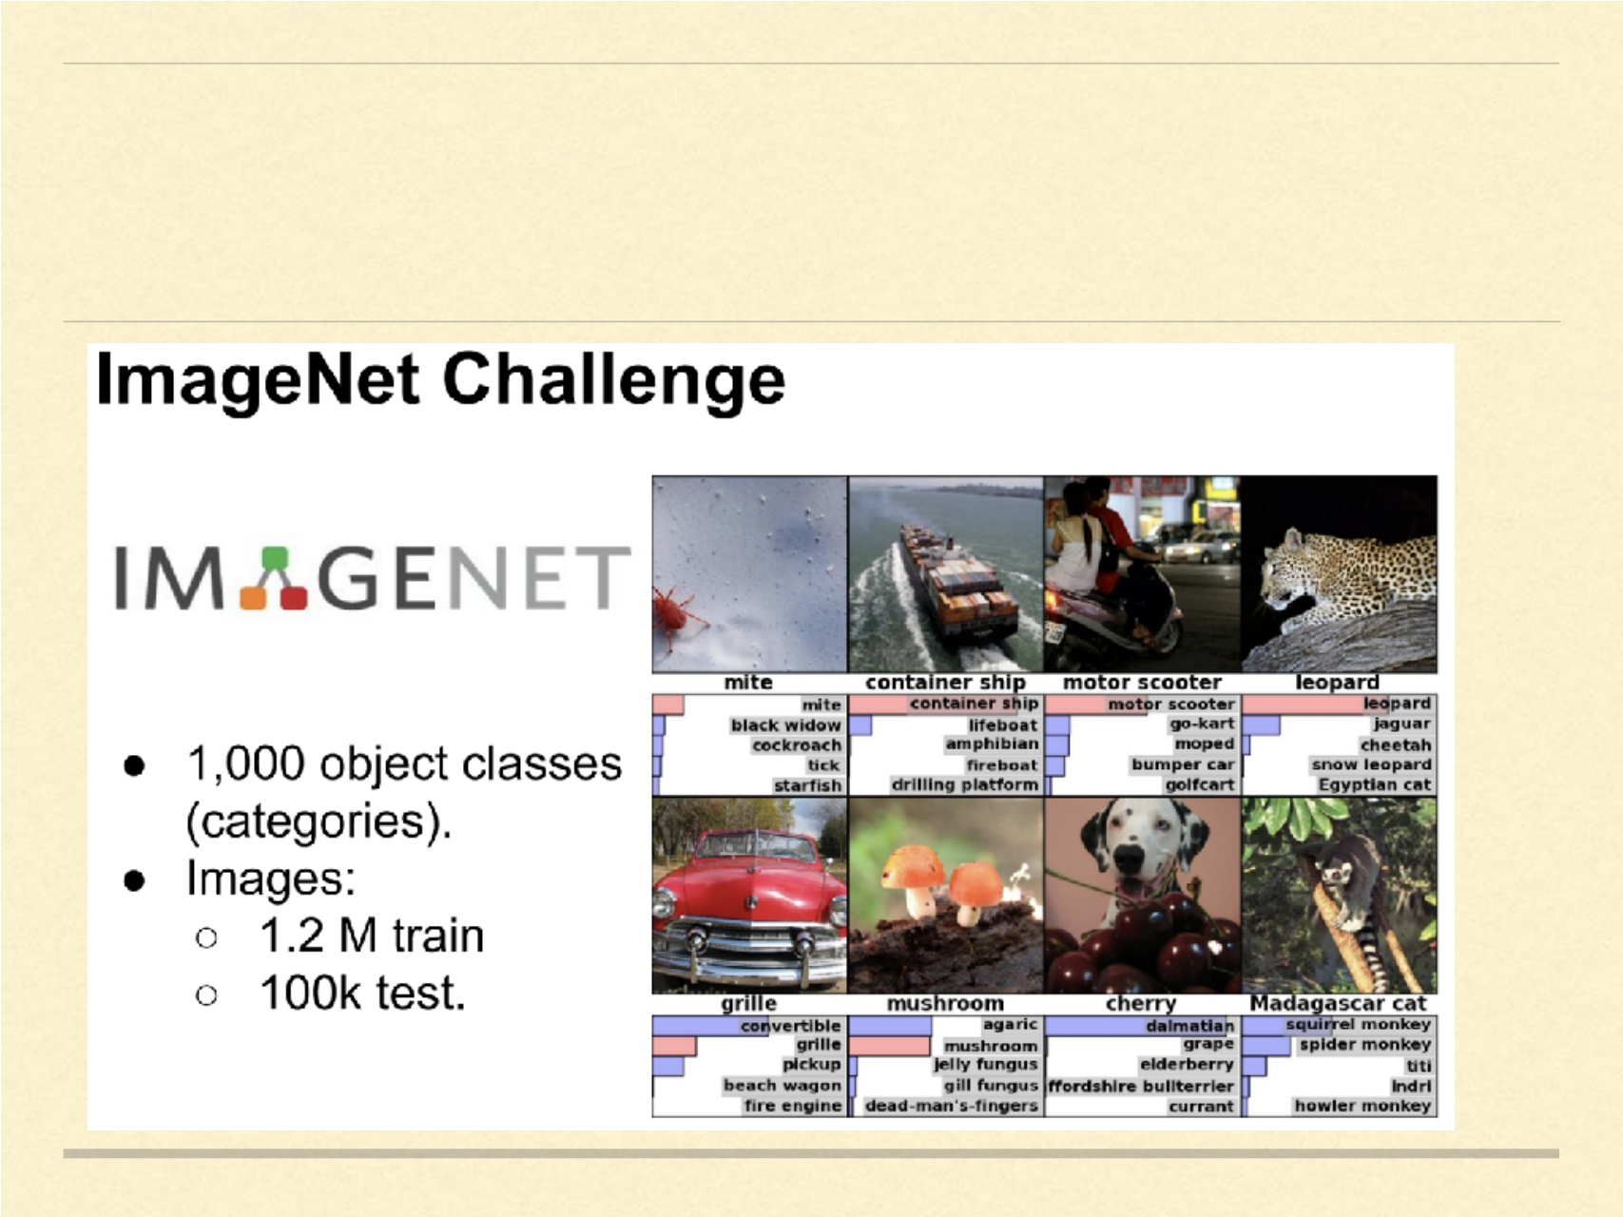
IMAGENET Competition

Slide 42

IMAGENET Competition
The ImageNet Large Scale Visual Recognition Challenge (ILSVRC) based on
the data in Imagenet opened in 2010.
Soon became a benchmark for how well image classification algorithms fared
against the most complex visual dataset assembled at the time .
Algorithms performed better when trained on Imagenet.
Competition ran for 8 years.
In 2012, the deep neural network submitted by Alex Krizhevsky, Ilya Sutskever,
and Geoffrey Hinton performed 41% better than the next best competitor,
demonstrating that deep learning was a viable strategy for machine learning
Accuracy went from 25% to < 5% through the course of ILSVRC.

Slide 43
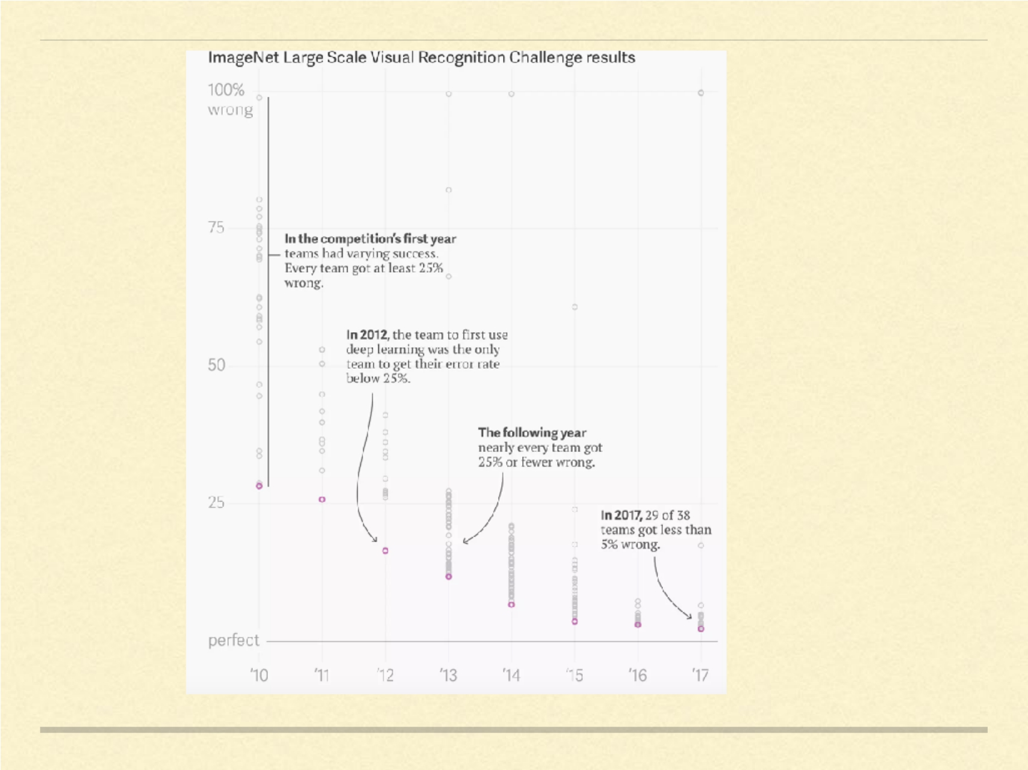

Slide 44

IMAGENET
If the deep learning boom we see today could be attributed to a single event,
it would be the announcement of the 2012 ImageNet challenge results .
Deep learning research exploded.
Imagenet went from a poster on CVPR to benchmark of most of the
presented papers today.
“It was so clear that if you do a really good on ImageNet, you could solve
image recognition,” - Ilya Sutskever
Without Imagenet, the deep learning revolution would have been delayed.
After LeNet-5 for reading handwritten cheques, deep ConvNets (and
Hinton?) needed a much bigger data to be useful in the real world .

Slide 45
Progress in Image Recognition

Slide 46

AlexNet
ILSVRC 2012.
First successful use of deep convnet for large scale image classification. Possible because of
large amounts of labelled data from ImageNet as well as computations on 2 GPUs.
ReLU non-linearity activation functions, finding that they performed better and decreased
training time relative to the tanh function. The ReLU non-linearity now tends to be the default
activation function for deep networks.
Data augmentation techniques that consisted of image translations, horizontal
reflections, and mean subtraction. They techniques are very widely used today for many
computer vision tasks.
Dropout layers in order to combat the problem of overfitting to the training data.
Proposed style of having successive convolution and poolinglayers, followed
by fully - connected layers at the end is still the basis of many state-of-the-art networks
today.

Slide 47

Clarifai
ILSVRC 2013.
Matthew Zeiler, a PhD student at NYU in 2013 and Rob Fergus won the
2013 competition.
Matthew Zeiler built Clarifai based off his 2013 ImageNet win, and is now
backed by $40 million in VC funding.
“widely seen as one of the most promising [startups] in the crowded, buzzy
field of machine learning.” ( Forbes)
Also, OverFeat: Integrated Recognition, Localization and Detection using
Convolutional Networks by Yan LeCun and team at NYU.

Slide 48
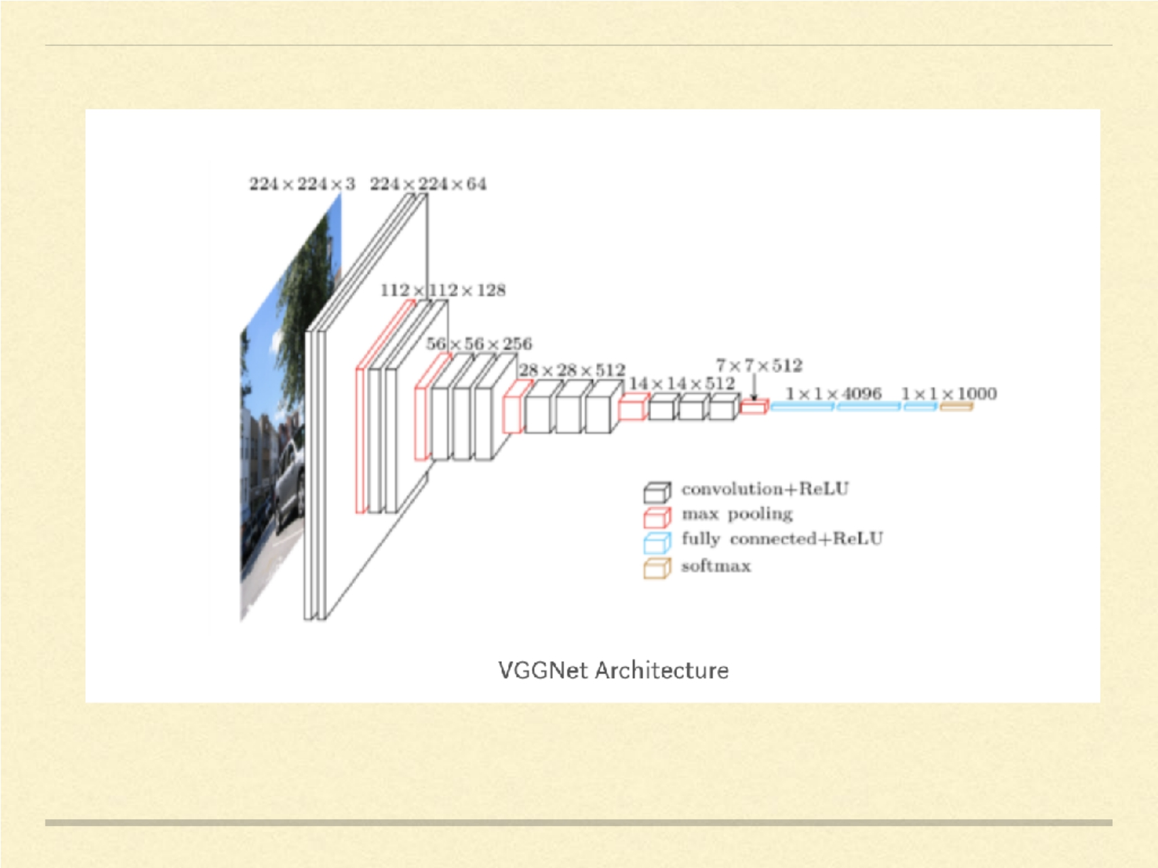

Slide 49

VGG
Visual Geometry Group @ Oxford, UK.
Idea: You didn’t really need any fancy tricks to get high accuracy. Just a deep network with lots
of small 3x3 convolutions and non-linearities will do the trick!
Two successive 3x3 convolutions has the equivalent receptive field i.e. the pixels it sees as a
single 5x5 filter, and 3 3x3 filter ~ a 7x7 filter. Same stimulation of pixels with added benefits of
smaller filters.
Decrease in the number of parameters.
Using a ReLU function in-between each convolution introduces more non-
linearity into the network which makes modeling decision function better.
As the spatial size of the input volumes at each layer decrease (as a result of the pooling layers),
the depth of the volumes increase since need more discriminative features to use for accurate
classification.
N ew kind of data augmentation: scale jittering.

Slide 50
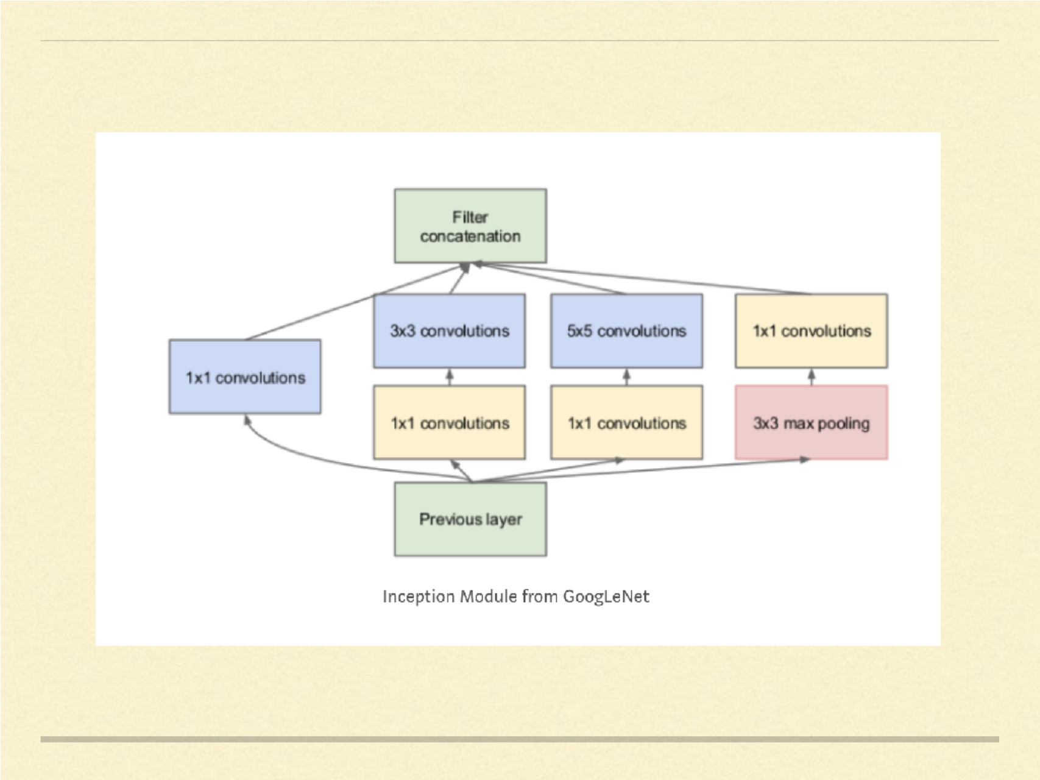

Slide 51

GoogleLeNet and Inception
First to really address the issue of computational resources along with multi-
scale processing.
Through the use of 1x1 convolutions before each 3x3 and 5x5, the inception
module reduces the number of feature maps passed through each layer, thus
reducing computations and memory consumption.
The inception module has 1x1, 3x3, and 5x5 convolutions all in parallel. The
idea behind this was to let the network decide, through training what
information would be learned and used.
GoogLeNet was one of the first models that introduced the idea that CNN
layers didn’t always have to be stacked up sequentially. The authors of the
paper showed that you can also increase network width for better
performance and not just depth.

Slide 52
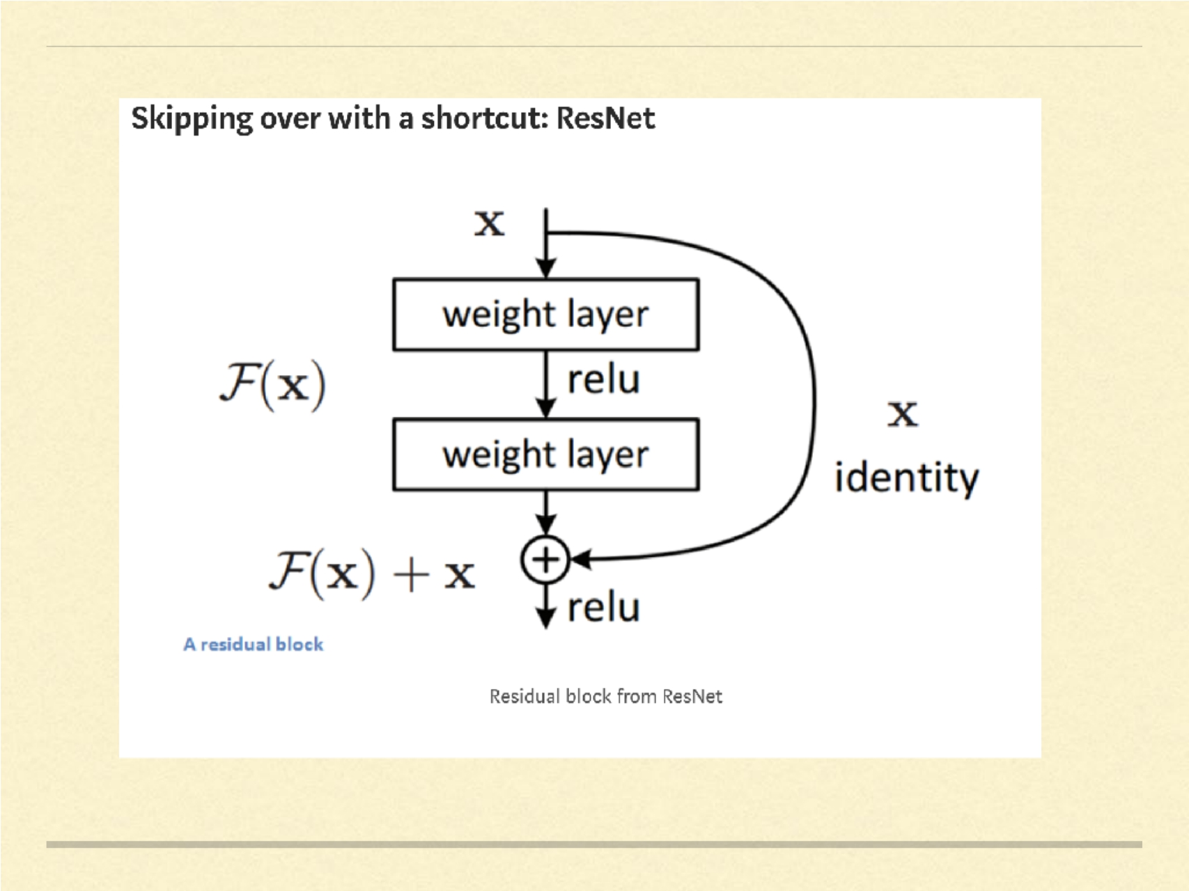

Slide 53

ResNet
The ResNet architecture was the first to pass human level performance on
ImageNet.
Main contribution of residual learning is often used by default in many state-of-
the-art networks today.
A naive stacking of layers to make the network very deep won’t always help
and can actually make things worse.
The idea is that by using an additive skip connection as a shortcut, deep layers
have direct access to features from previous layers. The allows feature
information to more easily be propagated through the network. It also helps
with training as the gradients can also more efficiently be back-propagated.
The first “ ultra deep ” network, where it is common to use over 100–200 layers .

Slide 54

Impacts of IMAGENET
Transfer learning: researchers soon realized that the weights learned in state of the art
models for ImageNet could be used to initialize models for completely other datasets and
improve performance significantly.
Achieving good performance with as little as one positive example per category.
Pre-trained ImageNet models have been used to achieve state-of-the-art results in tasks such as
object detection
semantic segmentation
human pose estimation
video recognition.
Applications in domains where the number of training examples is small and annotation is
expensive. (e.g. DeCAF: A Deep Convolutional Activation Feature for Generic Visual Recognition )

Slide 55
“One thing ImageNet changed in the field of AI is suddenly people
realized the thankless work of making a dataset was at the core of AI
research. People really recognize the importance the dataset is front and
center in the research as much as algorithms.”
– Fei Fei Li, Creator or ImageNet and Chief Scientist Google Cloud.

Slide 56

Beyond IMAGENET
Google released the Open Images Database, containing 9 million
images in 6000 categories.
YouTube-8M Dataset - to accelerate research on large-scale video
understanding, representation learning, noisy data modeling,
transfer learning, and domain adaptation approaches for video.
Visual Genome - A knowledge database to connect structured
image concepts to language .
Fine-tuned ImageNet models are pushing the state of the art in
many traditional image datasets like CIFAR, PASCAL etc.

Slide 57
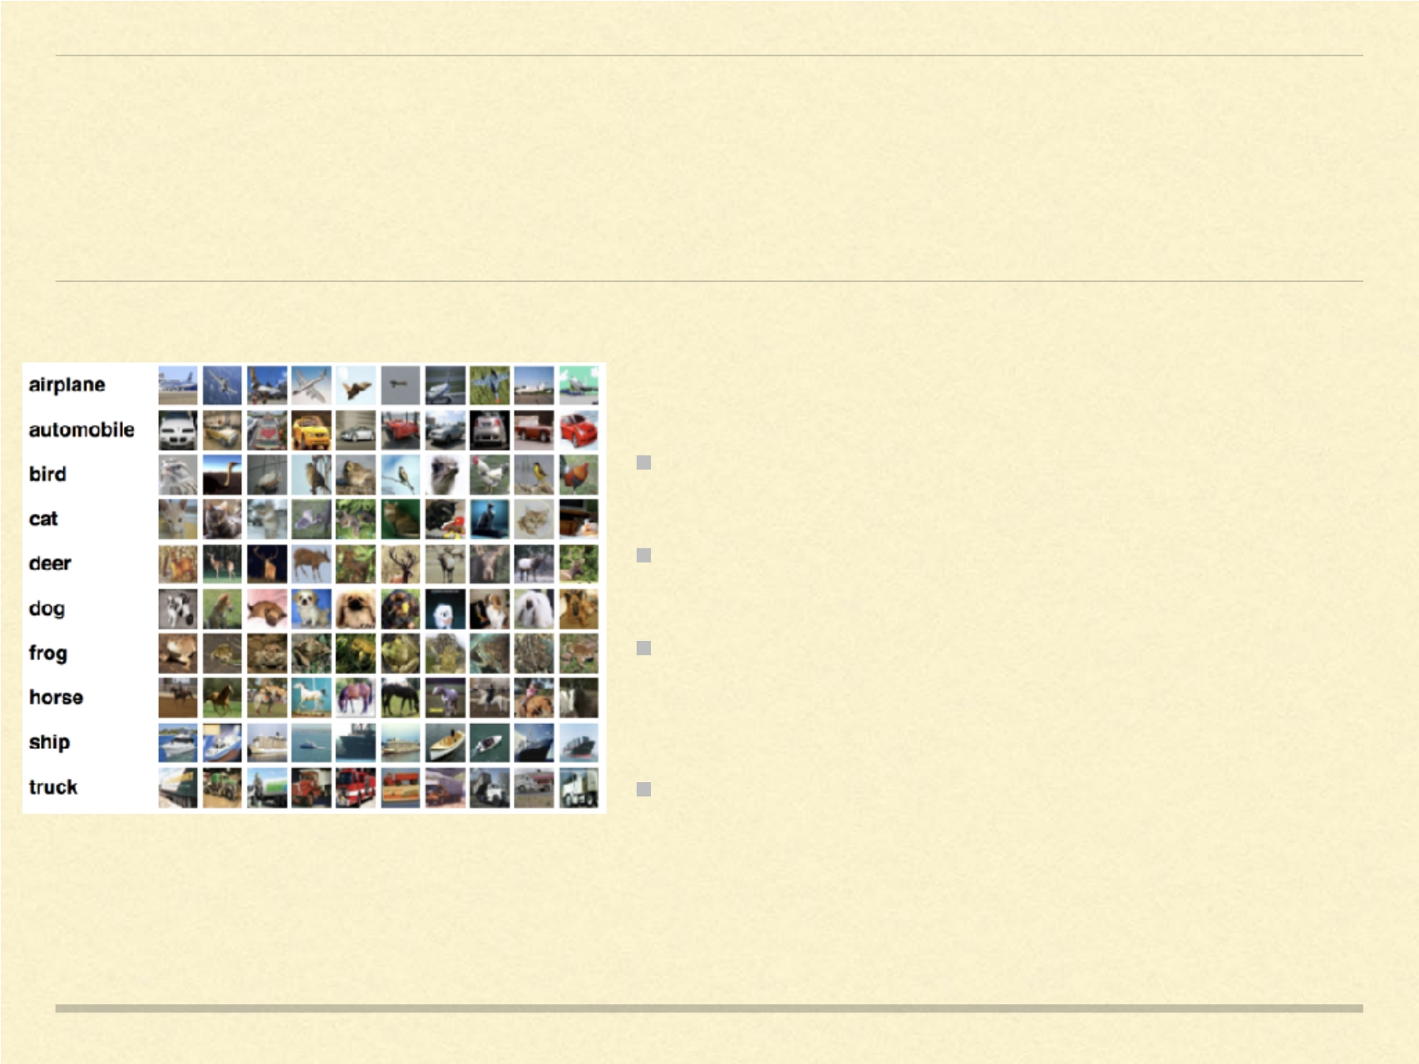
CIFAR
For image classification. Beyond digits.
60k color images with 10 classes.
Piggy-banking on the success of
IMAGENET and deep convnets.
SOTA : ShakeDrop regularization 2018

Slide 58
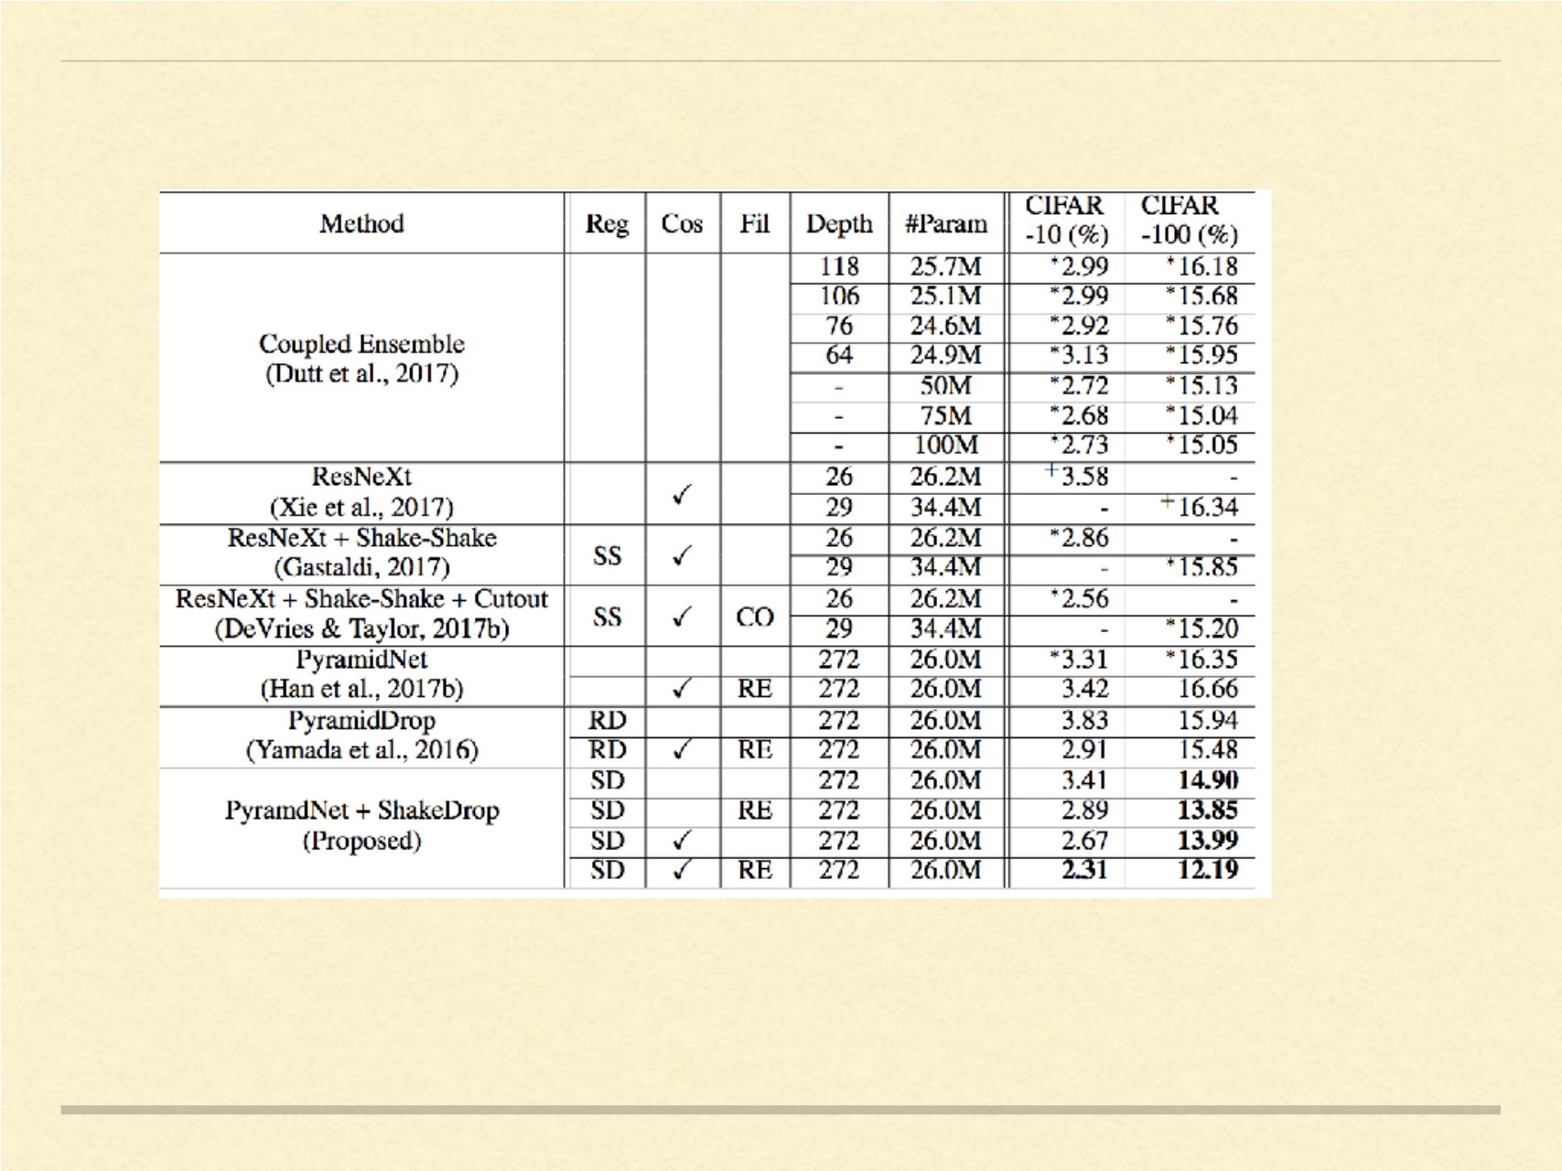

Slide 59
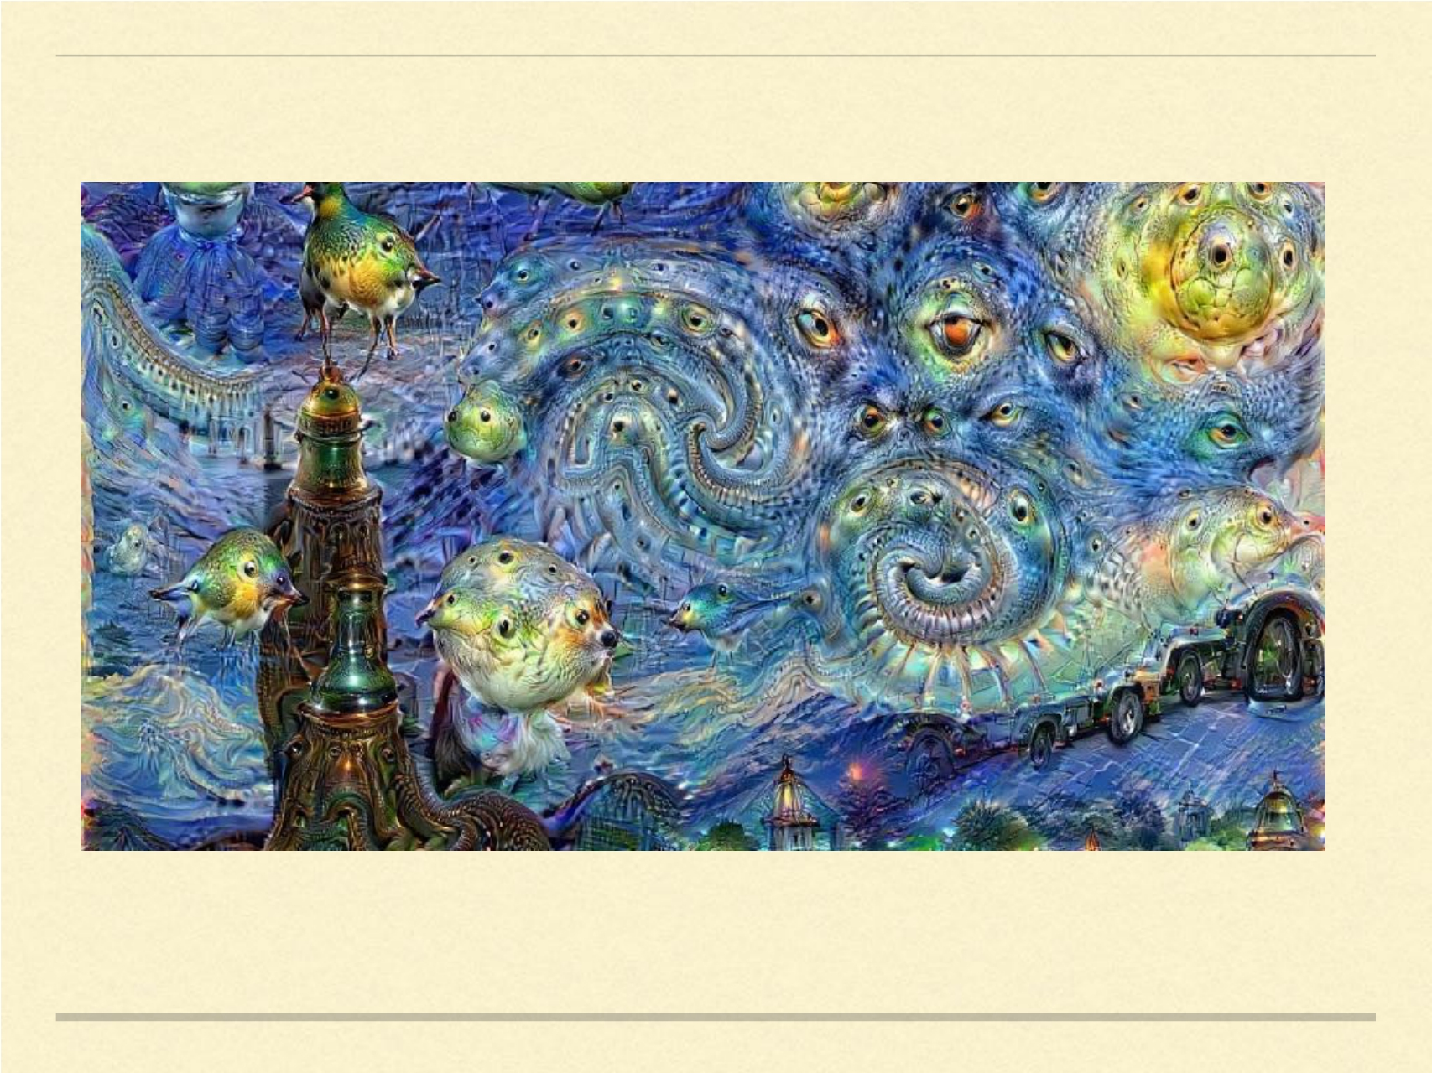

Slide 60
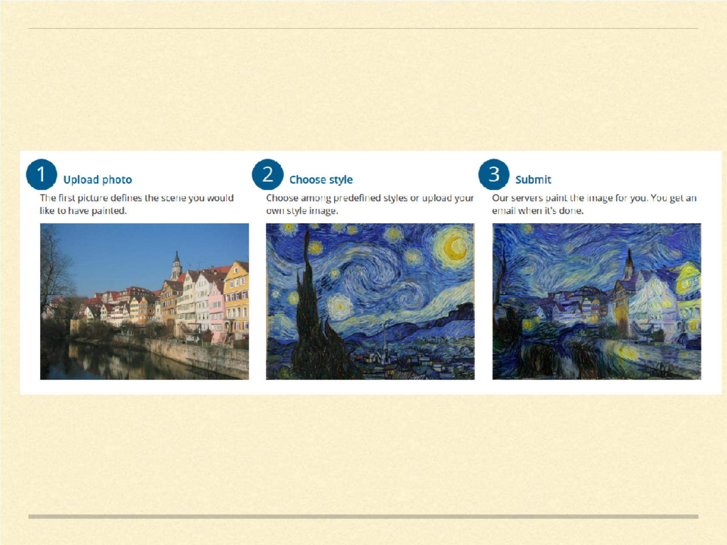

Slide 61
Thanks
@januverma

